Slide 1
PSE design document
Notes:
1
Welcome, etc.
We are gonna go over the design of the whole system and talk about largely about the connection between the components.
The app design is essentially a mvc modeled app.
The sys. Is separated in 2, front- and back-end
Questions will be referred to the appropriate person. If I cannot answer them.

Slide 2
Front-End
Notes:
First we’ll take a look at the front end.
There’s two ‘pages’ the landing page, for loging in and the page where the diagrams/ analysis is actually presented to the user.

Slide 3
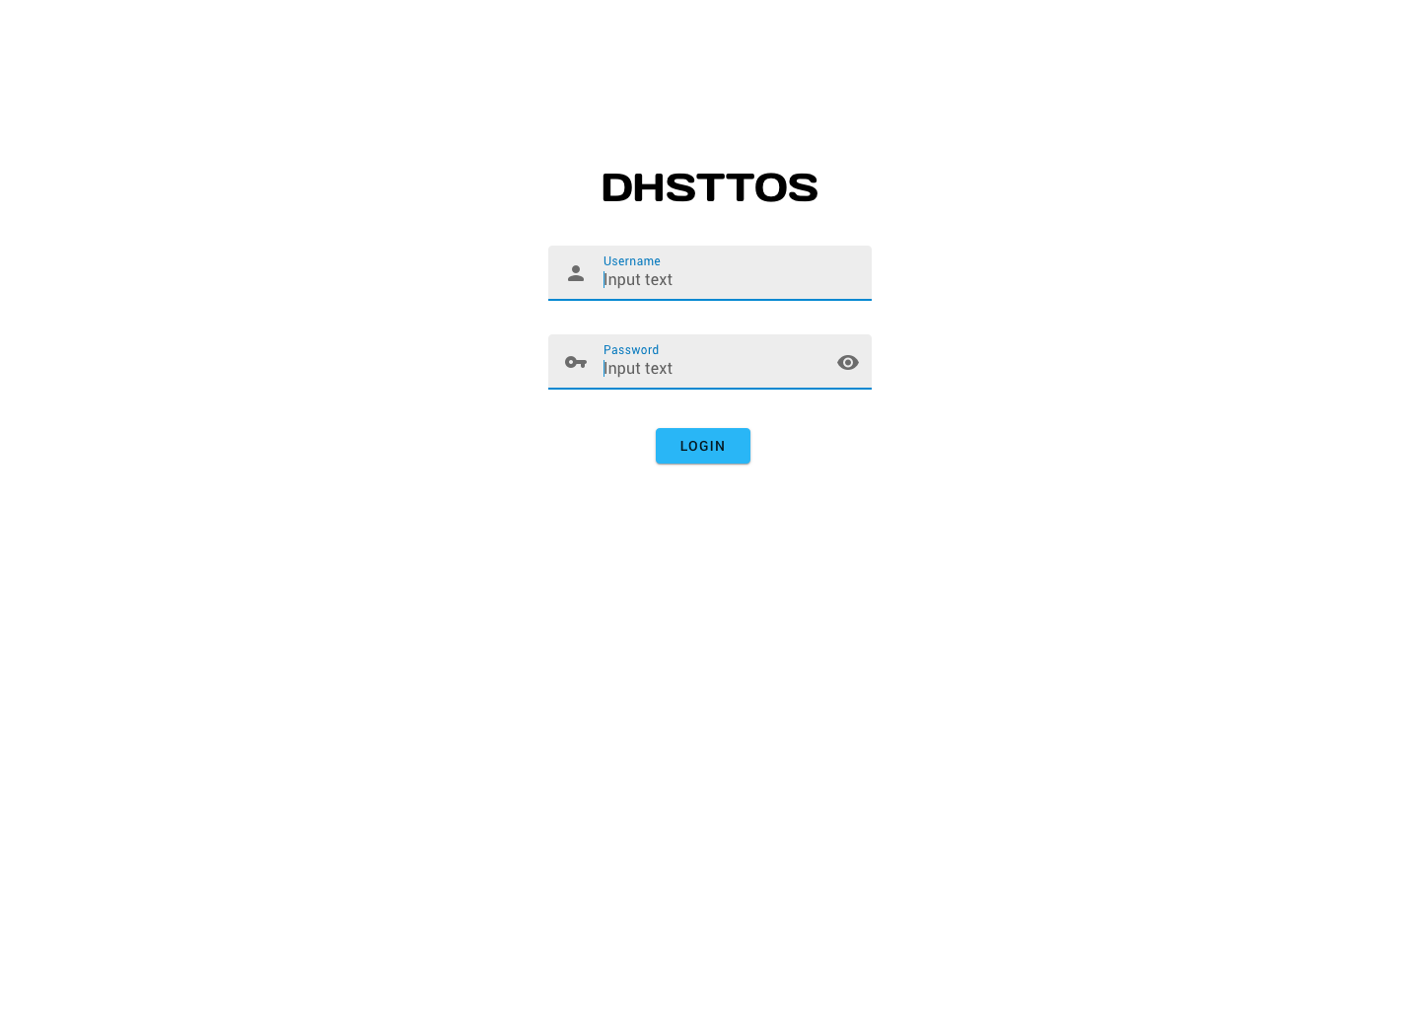
Notes:
When the user first opens the page he is presented with this screen, here he inputs his credentials and they’re sent over to the back-end for authentication.
Success: goto diagrams page.
Fail: display error message.
On succesfull login the back-end returns a cookie for that session.
We’ll talk later on about how the back-end does this. As well as UAC and User Management

Slide 4
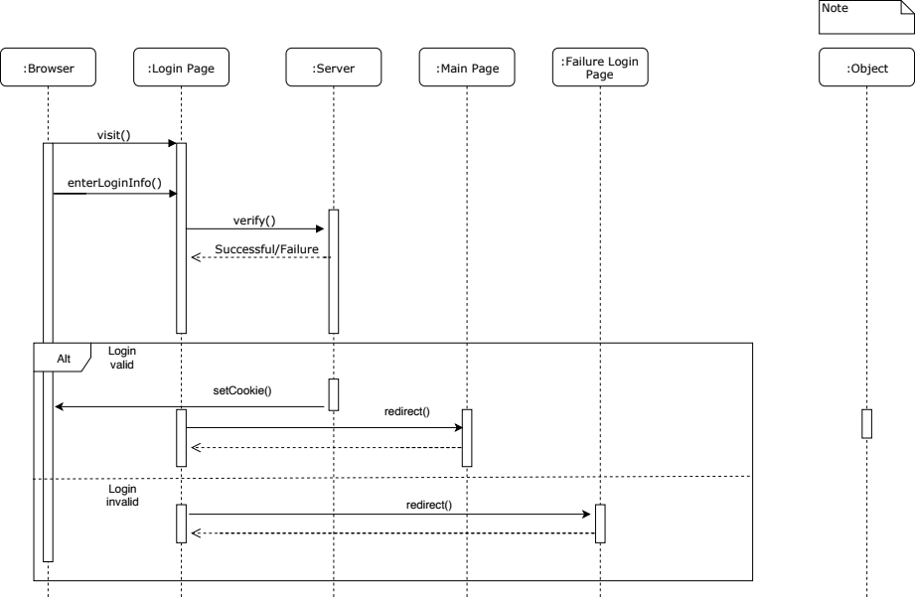
Notes:
This describes the workflow on loging in into the webapp.
We’re not gonna cover a lot of the sequence diagrams in the presentation since most of them are a bit overkill on the level of detail, but might be useful for answering specific questions.

Slide 5
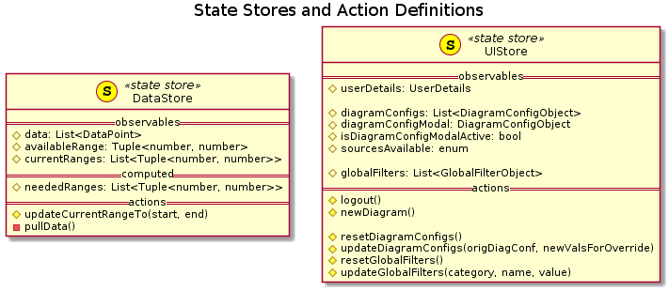
Front End
Notes:
These are the javascript objects we use in the front-end to store data and dispatch actions.
The uistore is used for the configuration of the whole front-end including the user credentials.
we’ll come back to this after looking at the diagrams page.

Slide 6
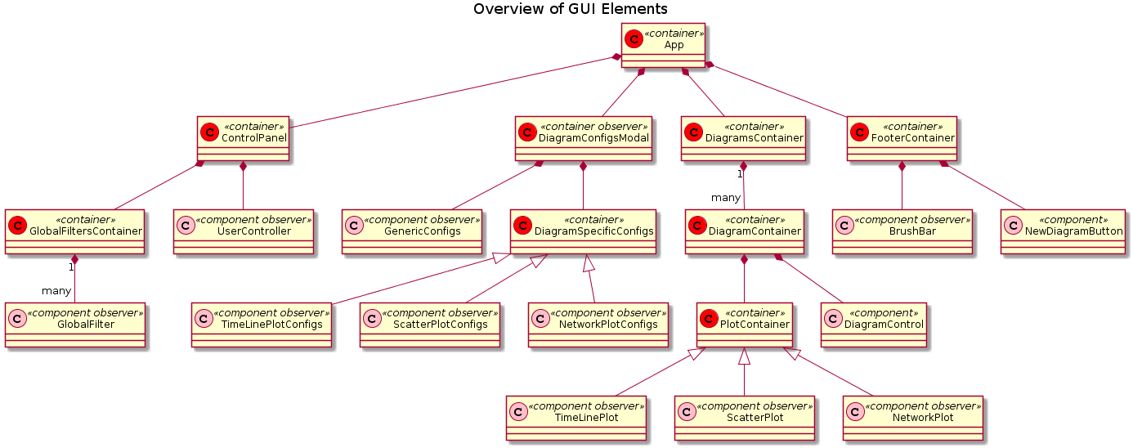
Notes:
so yeah this is how the UI components are structured in frontend. html, so hierarchical.

Slide 7
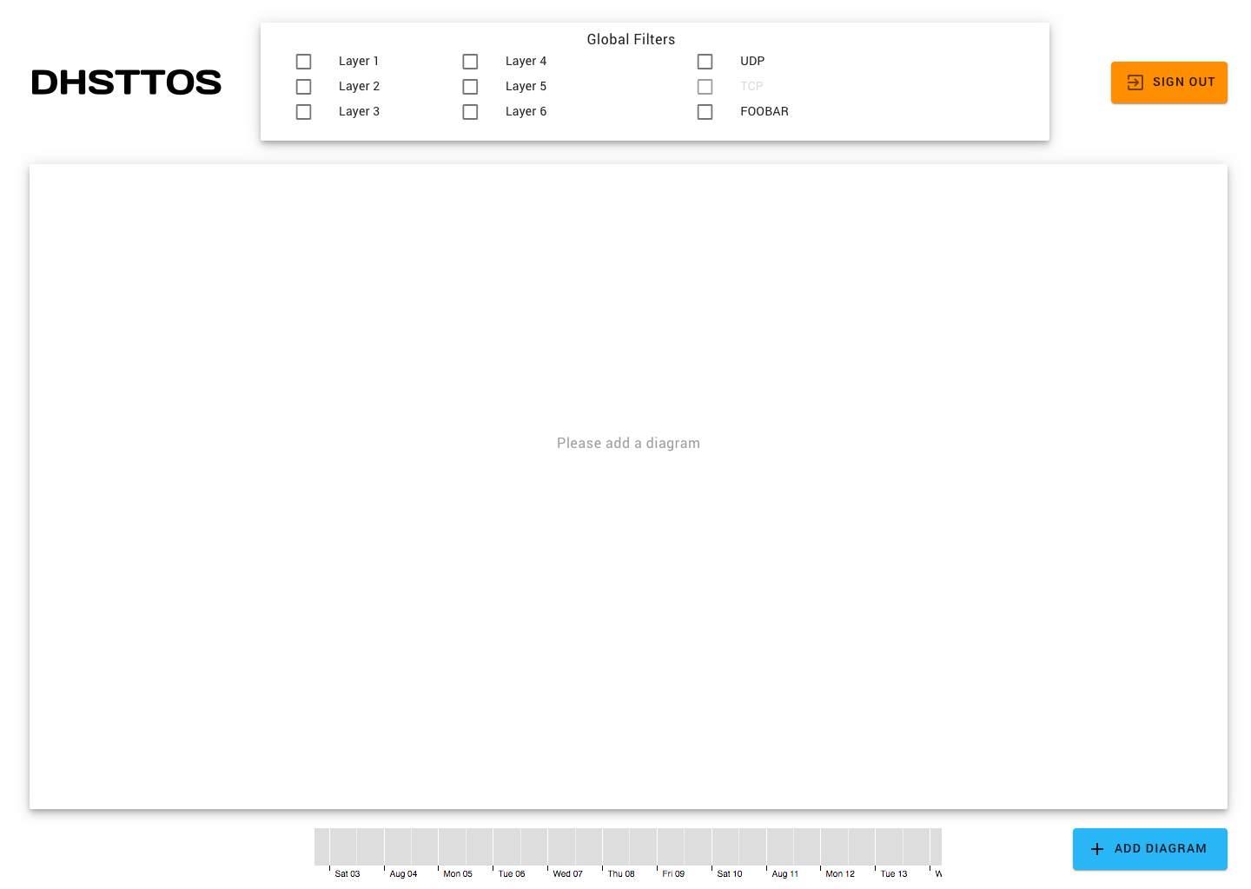
Notes:
This is the main view and controller part of the application, from here the user can make use of the info from the database.
For example, when making a new diagram, click on the blue button.
DESCRIBE PROCESS

Slide 8
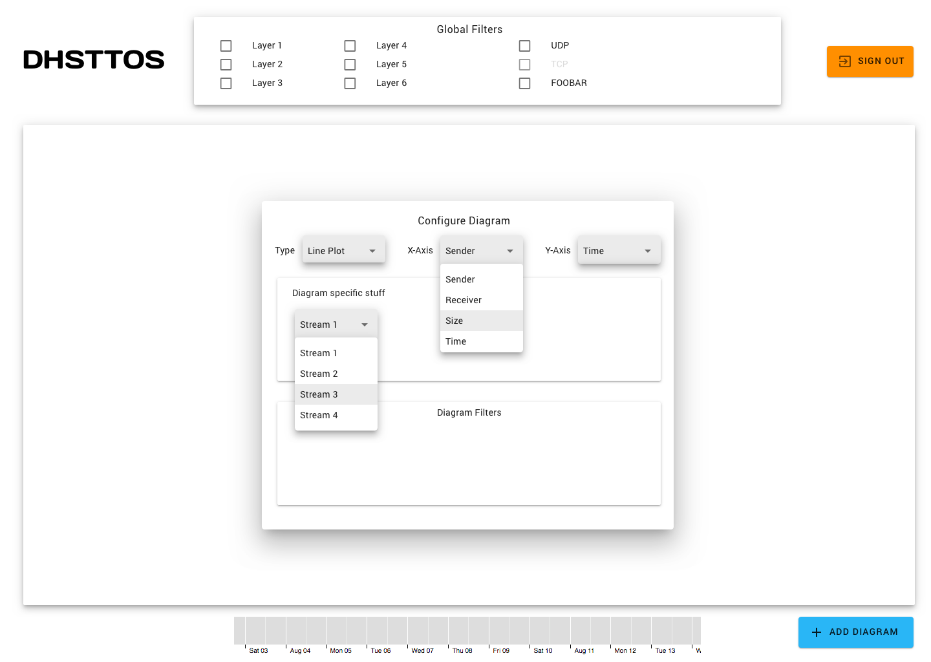
Notes:
Here the user set’s what the diagram is going to look like/ what collection from the database it’s going to pull from.

Slide 9
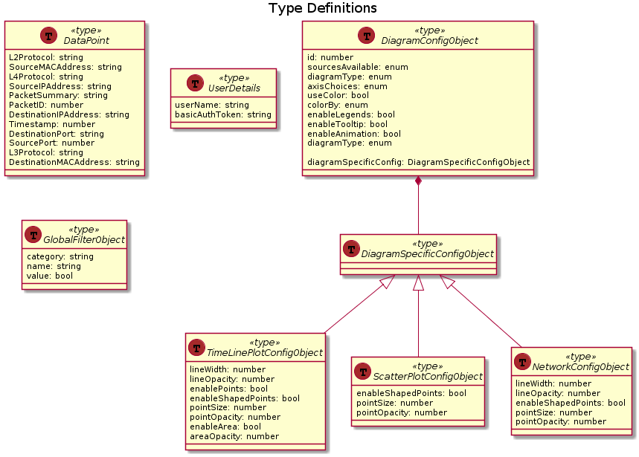
Notes:
These are the how the js objects storing the configs will look like. These objects are used inside the data and app store objects we have seen a few slides back.
This allows for expand-ability since adding a new diagram type would mean to add a new specific diagram options, and a diagram type class to handle the actual drawing. <- this line/this whole slide would be better put just behind 5th slide IMO

Slide 10
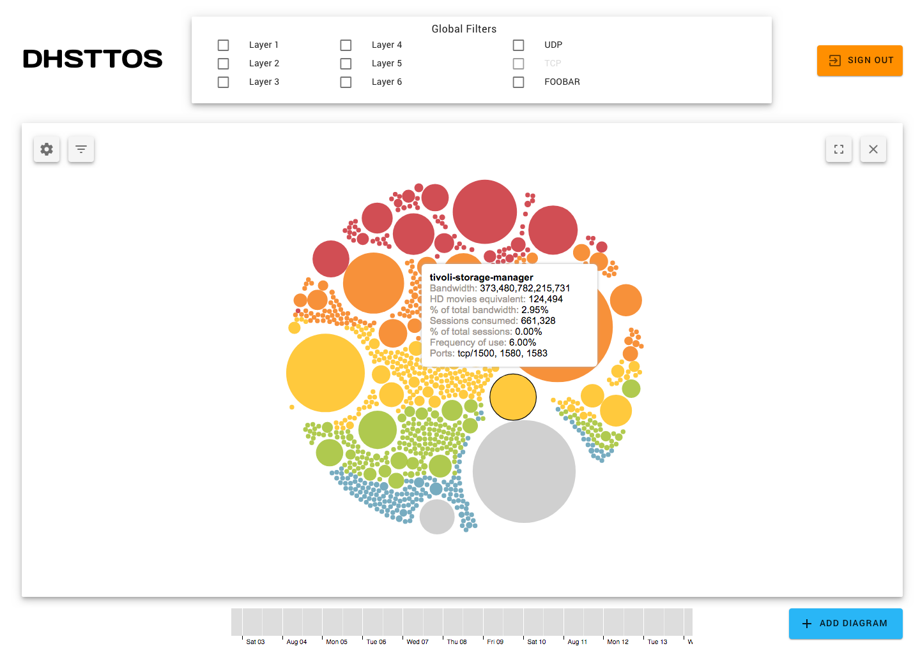
Notes:
Result. When user confirms the add diagram modal, a new diagram will pop up

Slide 11
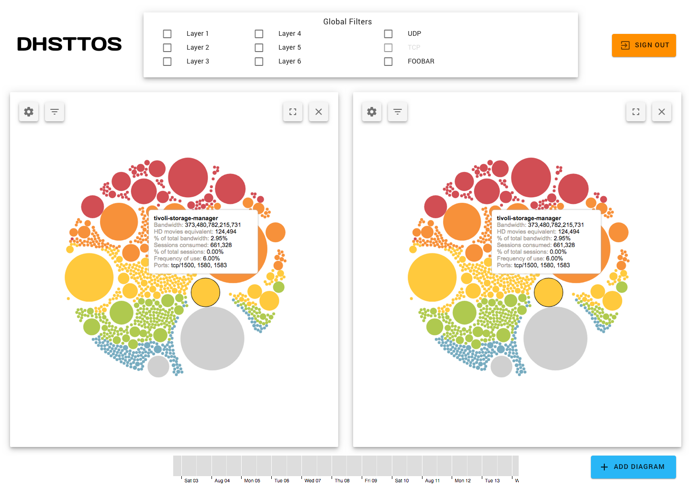
Notes:
The user can do this multiple times
Adding mutliple: basically same thing - press add diagram, config, confirm

Slide 12
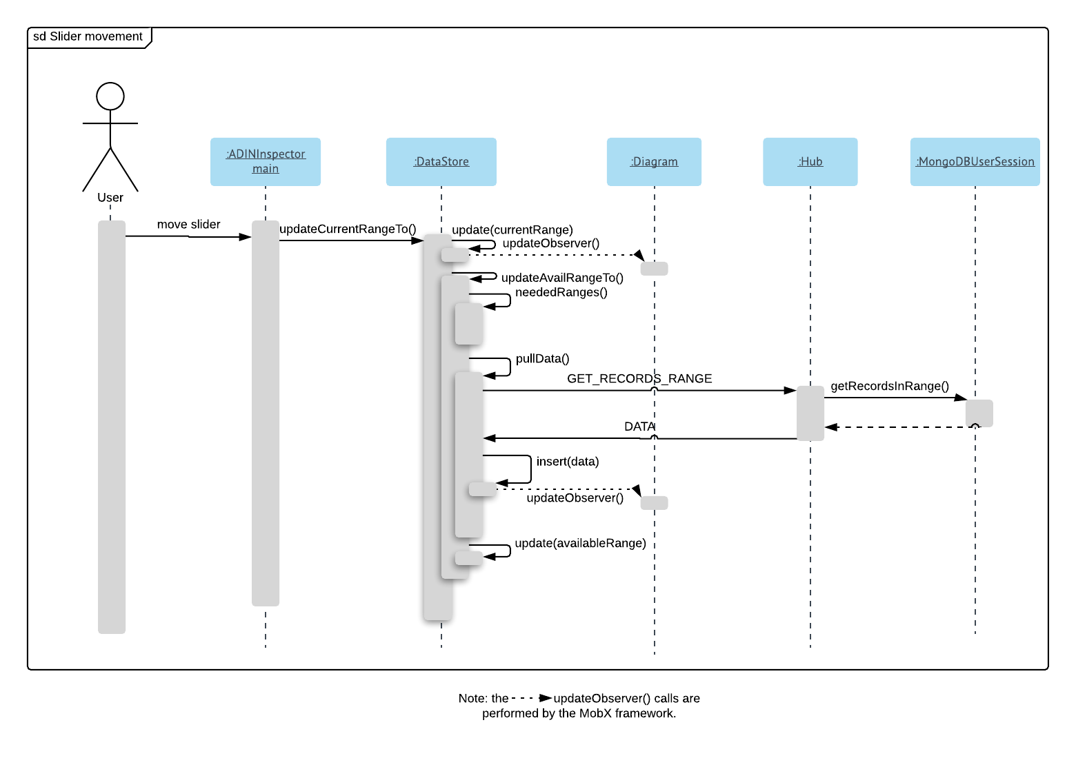
Notes:
The diagrams are all linked to a slider that shows an overview of the start and end of all the data we’re displaying at the moment.
Each diagram looks at the store object and tries to retrieve the data it needs,if the date is not present the data is requested( pulled ) from the back-end. When the data is aquired the store object is updated and the data is given back to the diagrams.

Slide 13
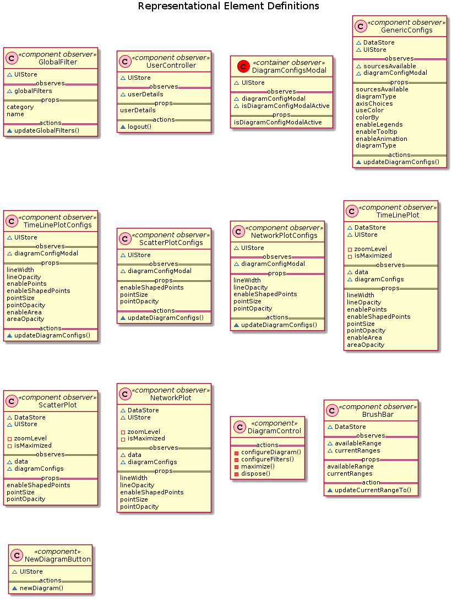
Notes:
Since we have multiple diagrams, each type of diagram is associated with a “class”, each diagram is also associated with a configuration class storing the specifics on how the diagram is drawn. Example line width.
As well as all elements from the UI having an associated class implementing the specific behaviour.
Honestly nothing to talk about here, just how the UI components will look like if we put them down as UML class diagram LOL. Or you can hand this to me to explain when presenting - Leo

Slide 14
Front End
Notes:
Loop back and explain how after using the UI this has changed. Please explain to me or better, write it down how this communicates with the diagrams.

Slide 15
Back-end
Notes:
Now for the back-end
We use Java as programming language because it has APIs for MongoDB, Kafka, and websockets ,is well supported by development tools (testing, deployment etc.). As well as the performance gain from using the Kafka Java API vs python or others.
Like with the FE we tried to keep modularity in mind like in the Interface for sessions and aggregation and the abstraction records.
Talk about how one would add a new record type, how this ties into Kafka and the ADIN framework.

Slide 16
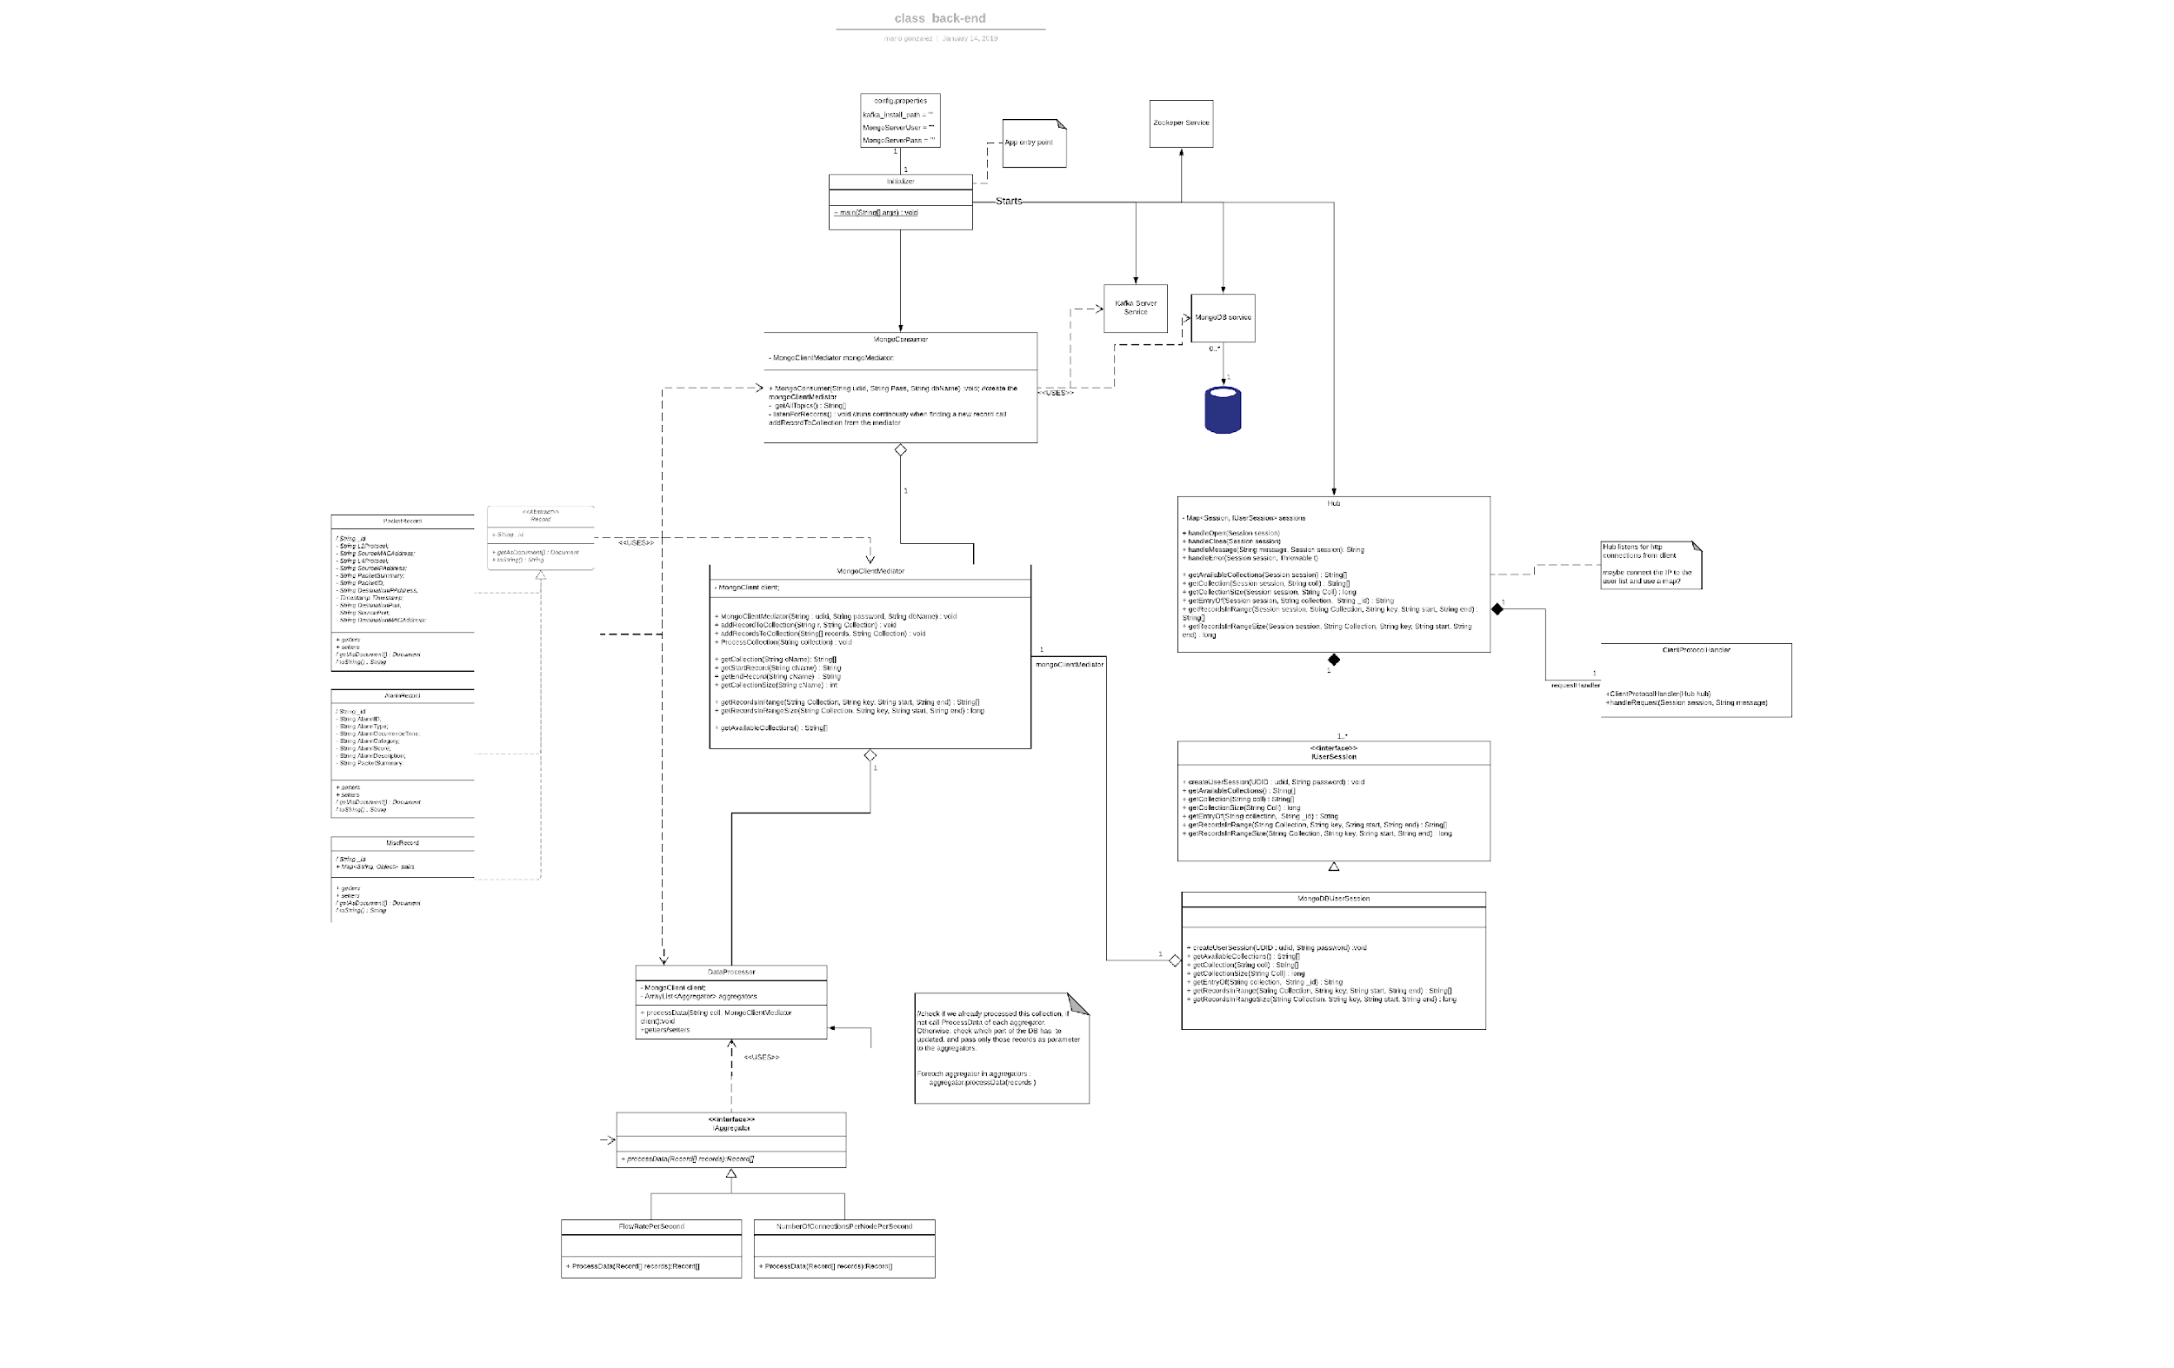
Notes:
Here’s the whole back-end modeled in a class diagram, for the presentation, and as you can see in the document we split it further into 3.
The initialization and Kafka record consumption
The Mongo Mediator and data processing
And the hub and web request handling.

Slide 17
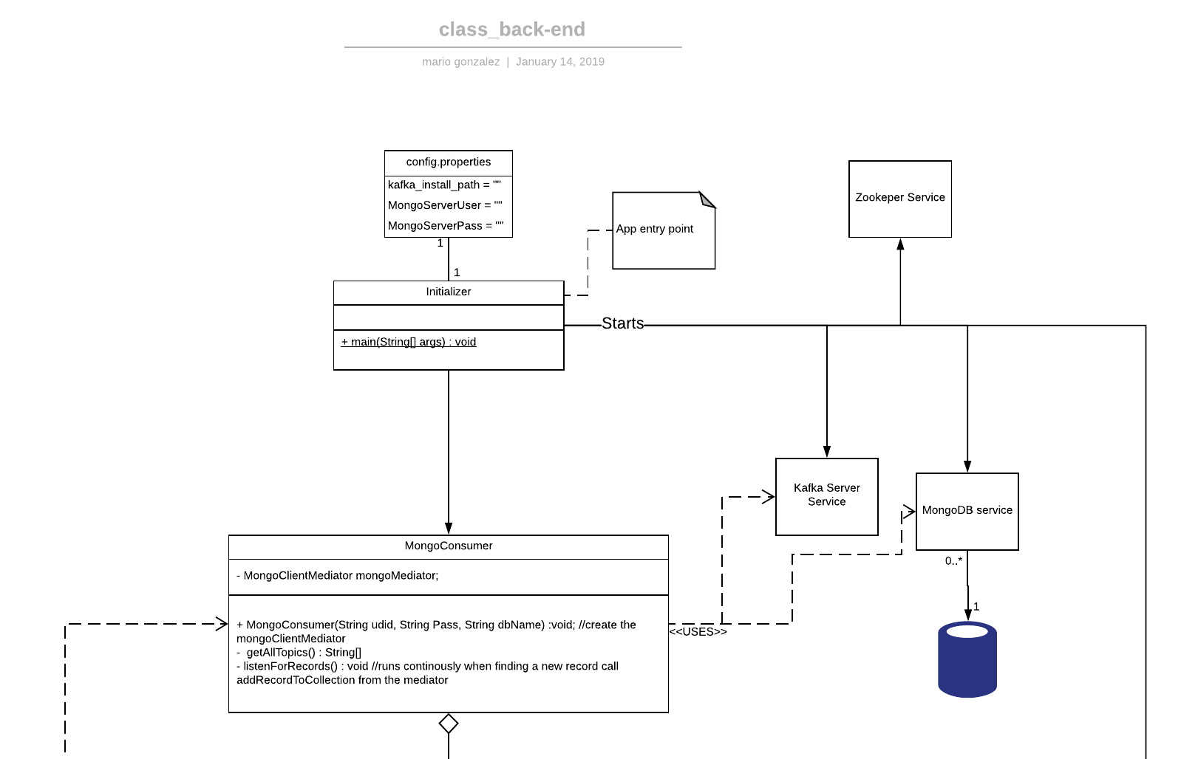
Notes:
When the app starts we need to make sure that all nec. Components are up an running
Afterwards we start the Mongo consumer and it does the loopy-loo grabbing more data.
We also start the hub to listen in for login attempts
(credentials and other config is provided via a properties file.)

Slide 18
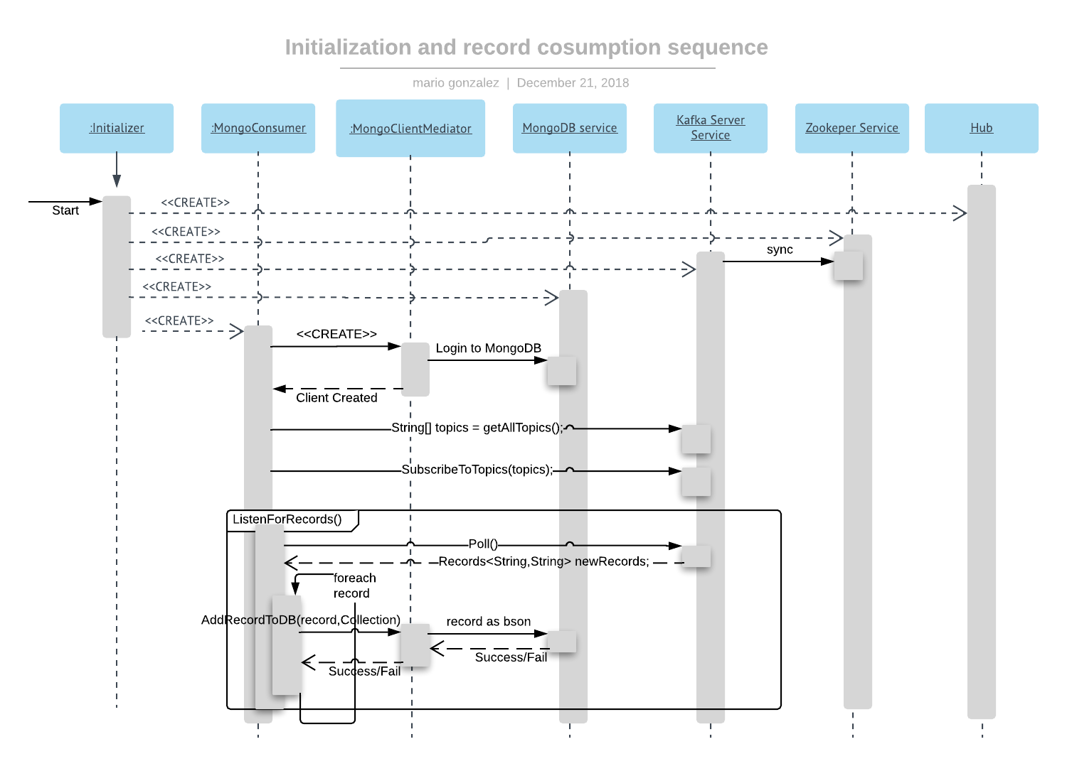
Notes:
The behavior I described is visualized here (go step by step)
Segway to data processing

Slide 19
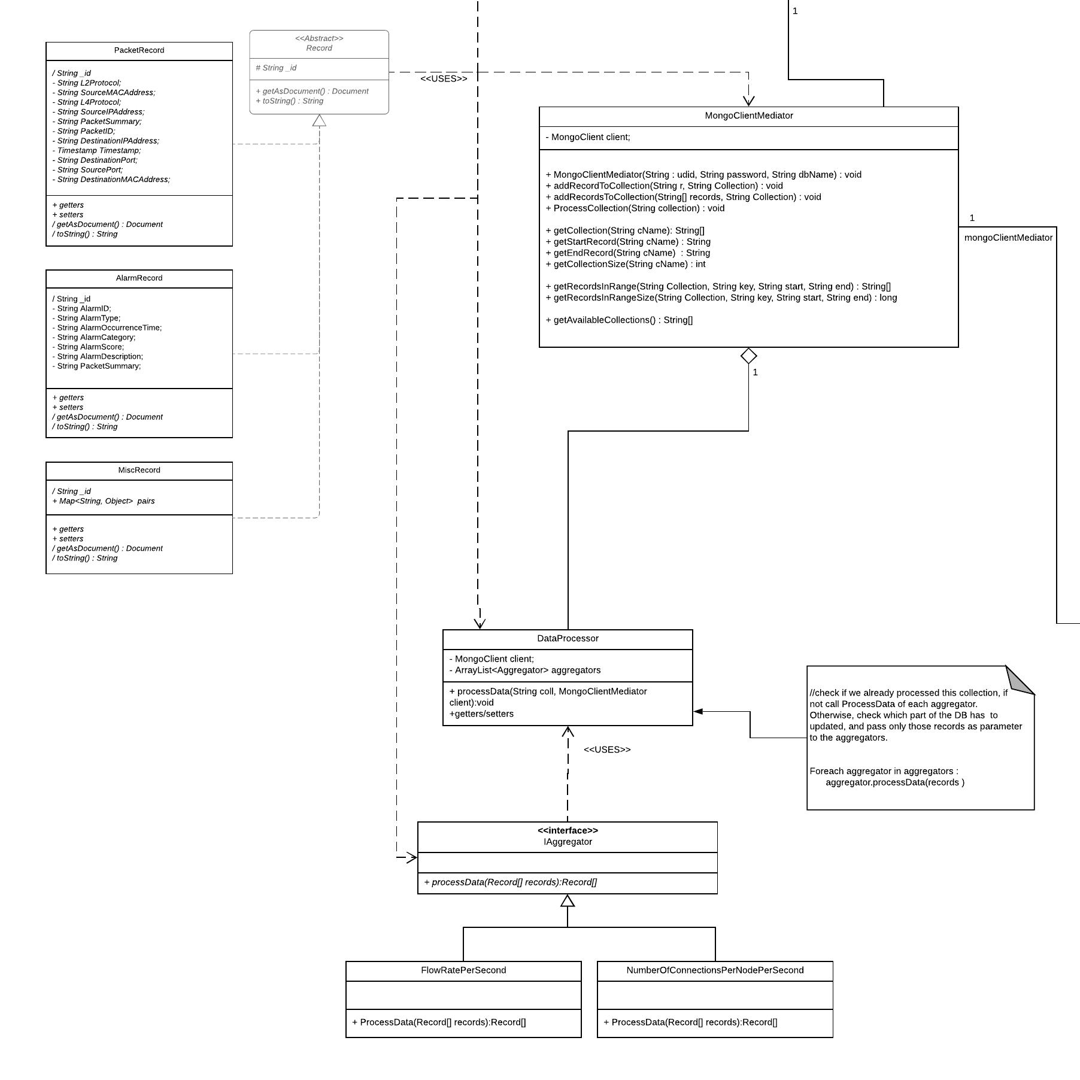
Notes:
Every user (and the mongo consumer) is associated with one client mediator for concurrency.
When adding and removing from Mongo or reading from Kafka we generate a Record class derivate for easily manipulating and working with them
From Json → java obj → bson object to store
Other way for passing forward
Specifics on data storage are on the document.

Slide 20
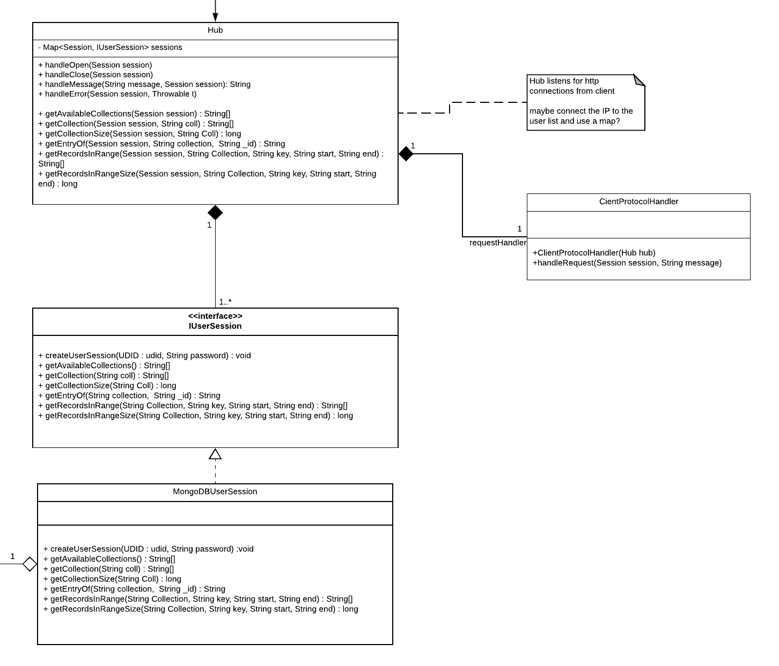
Notes:
Apache Tomcat as webserver Reason: established platform for web applications, integrates
well into a java-oriented development environment.
Interface because we wanted to make it modular maybe to be able to read data directly from kafka
All data passed to the FE comes only from kafka because it simplifies Data manipulation and storage and provides a single point of failure for the backend.

Slide 21
Questions?

